Slide 1
Bank Analytics/Loan Analytics
  Group : 6
  Syed sohaib shabbir
  Shreyas Gawankar
  Mathew R
  Pulivarthi Srikanth

Slide 2
Project Summary: Bank Analytics Dashboard
The bank Analytics Dashboard is designed to provide a complete view of the bank’s loan and collection performance. It tracks key metrics such as total loan amount, total loans, total collection, total interest, delinquent clients, and default percentage.
The dashboard analyzes data from different perspectives—branch, state, product type, religion, loan grade, loan status, and customer age group—to identify trends and patterns. It also highlights disbursement trends and loan maturity, helping the bank understand performance over time.
Overall, this project helps management make informed decisions, monitor financial health, and improve loan portfolio quality through data-driven insights.

Slide 3
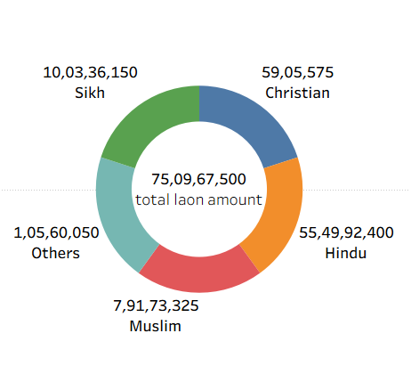
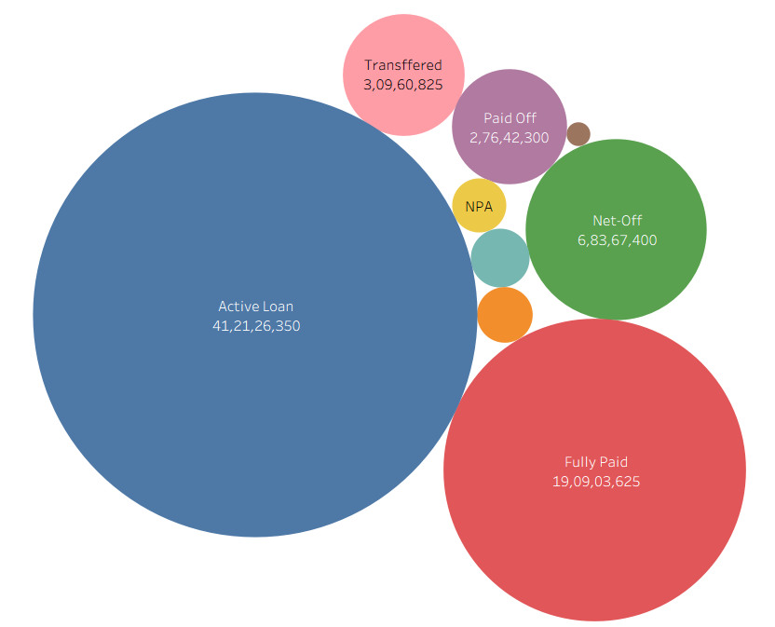
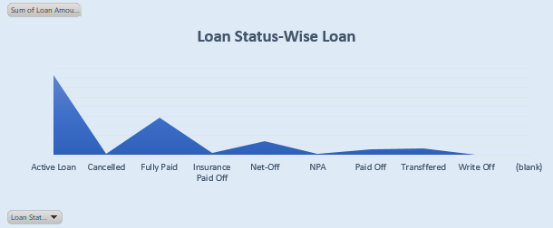
KPI’s
Charts and Visualization
Total Loan Amount Funded
Total Loans
Total Collection
Total Interest
Delinquent Client Count
Delinquent Loan Rate
Default Loan Rate

Slide 4
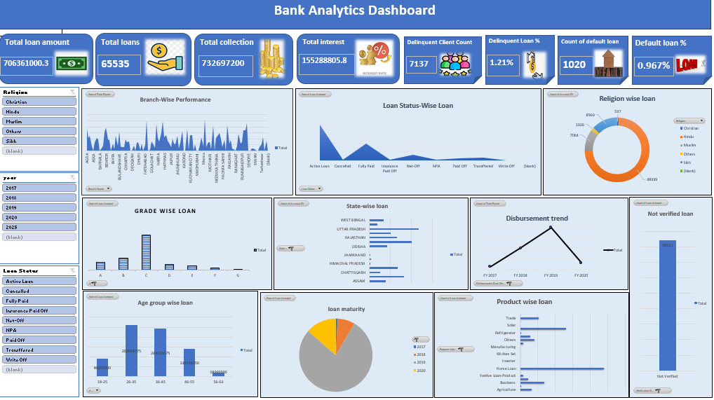
Excel Dashboard

Slide 5
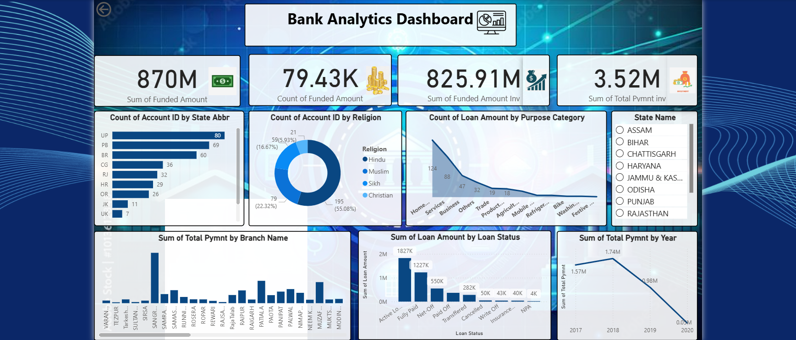
Power BI Dashboard

Slide 6
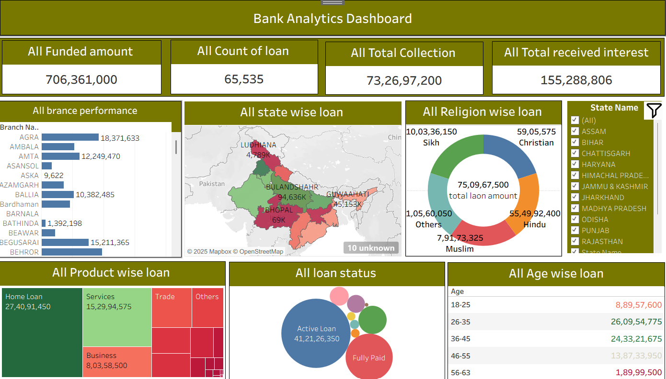
Tableau Dashboard

Slide 7
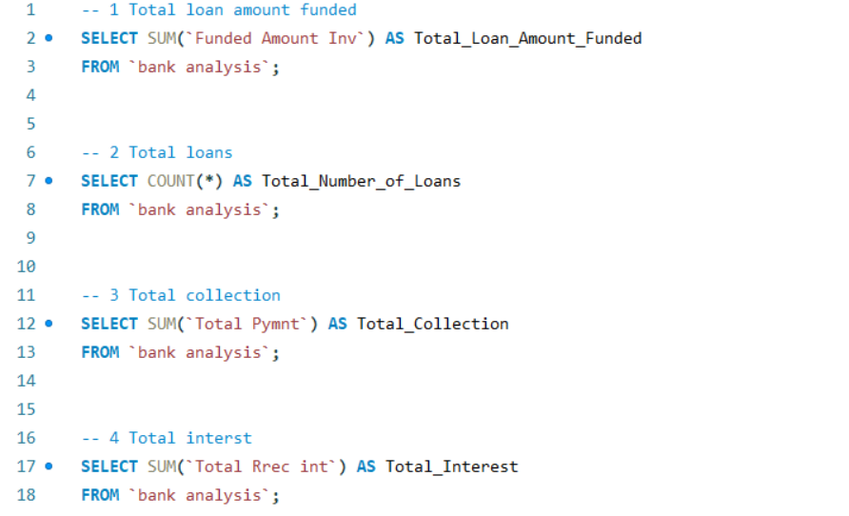
MySQL Queries

Slide 8
Key Takeaways:
The dashboard transforms raw banking data into actionable insights, giving a clear picture of loan performance.
It helps track financial strength through total loan amount, collections, and interest earned.
Risk indicators like delinquent clients and default rates make it easier to identify problem areas early.
By comparing loans across branches, states, and customer segments, the bank can pinpoint growth opportunities.
Visual trends in disbursement, product type, and loan maturity guide smarter business decisions.
Overall, the dashboard acts as a strategic tool for performance monitoring, risk control, and informed planning.

